Slide 1

SQL Project Tool: MySQL Workbench

Slide 2
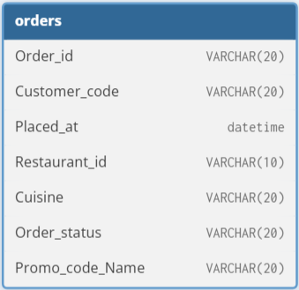
Table Schema

Slide 3
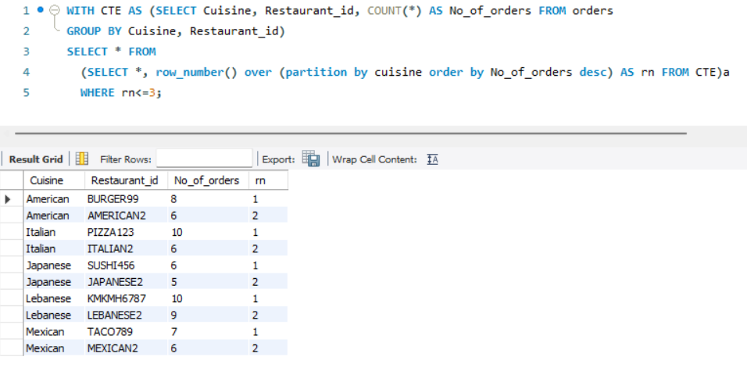
Top 3 outlets by Cuisine type

Slide 4
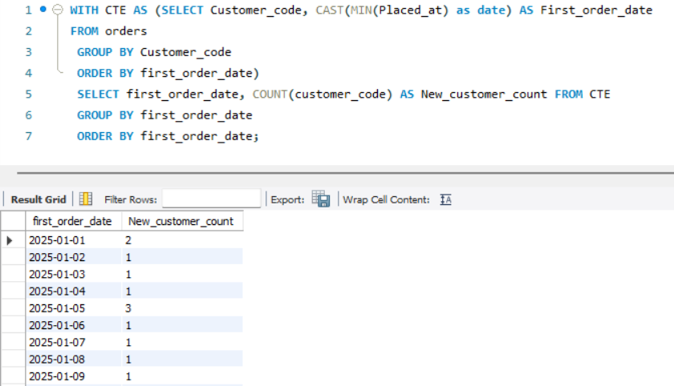
Count of new customers acquired every day from the launch date

Slide 5
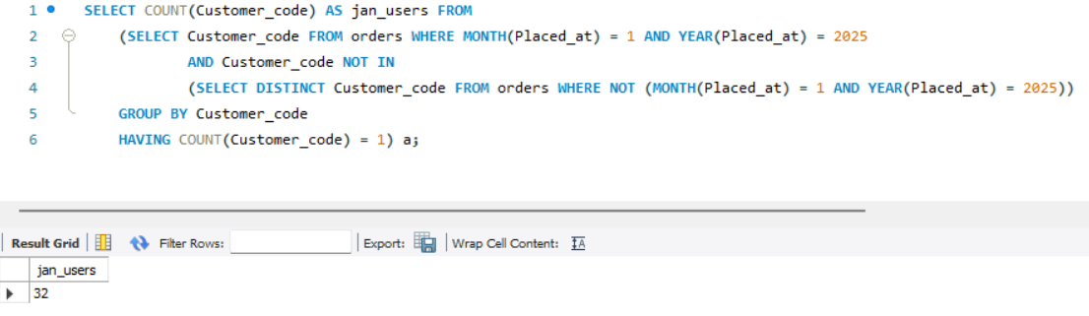
Count of all the users acquired with only a single order in January

Slide 6
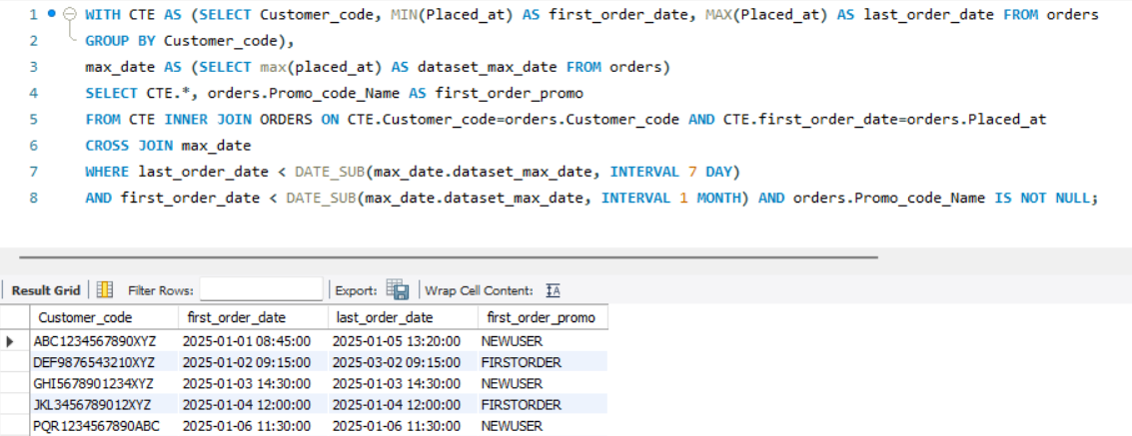
List of all the customers with no order in the last 7 days, but were acquired one month ago with their order on promo.

Slide 7
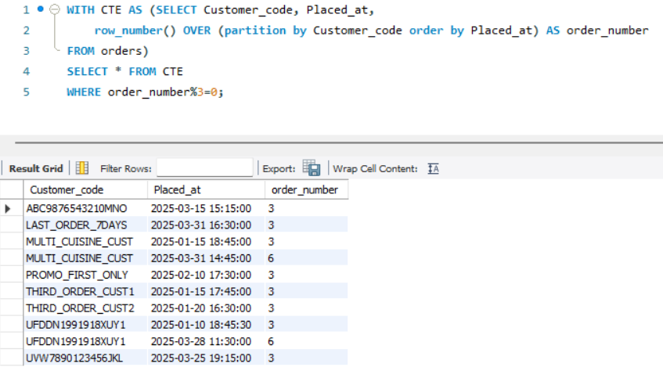
Create a trigger that will target customers after every third order with a personalized communication

Slide 8
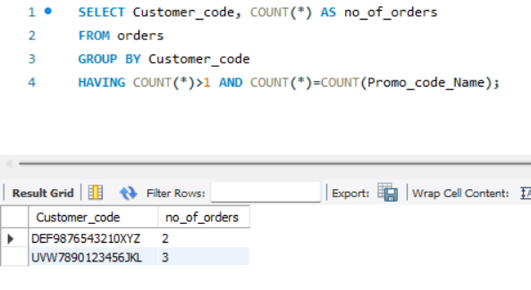
List of the customers who placed more than 1 order, and all their orders were on a promo.

Slide 9
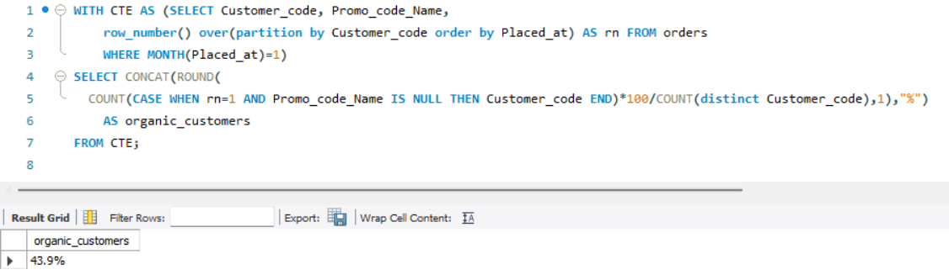
Percentage of customers organically acquired in Jan 2025 (placed their first order without a promo code)

